Slide 1
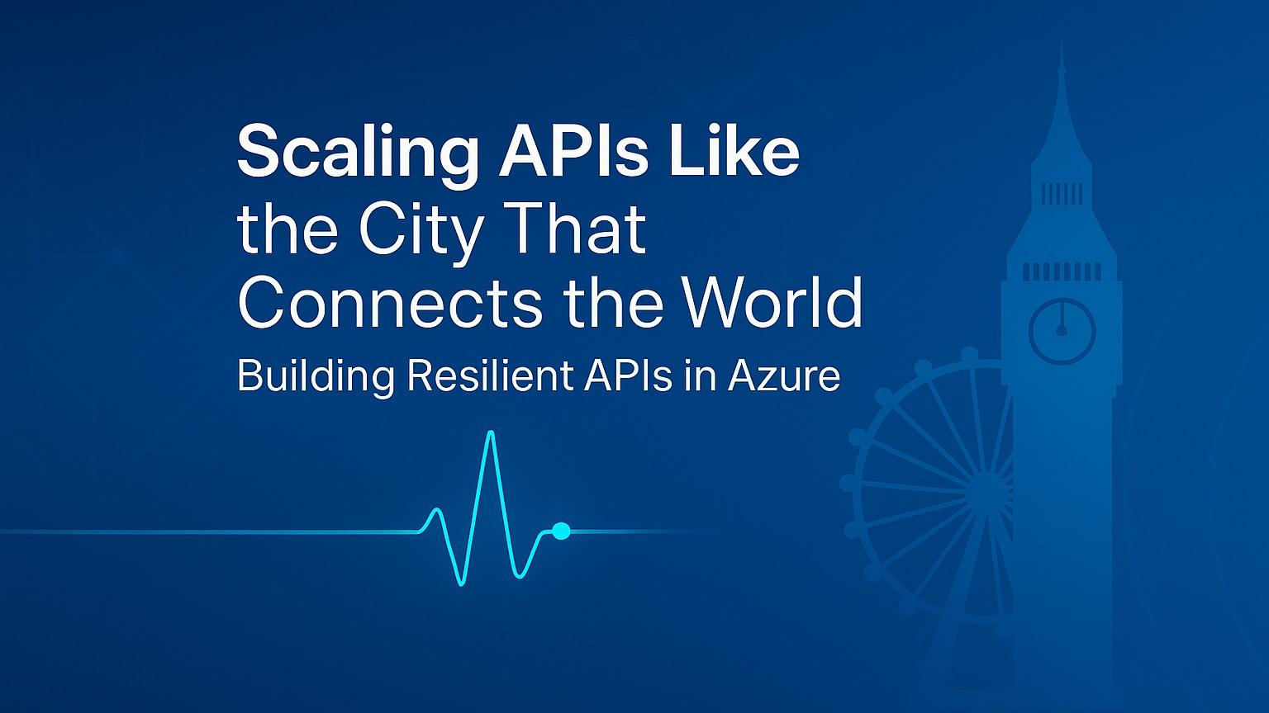
Notes:
Welcome everyone!
Today, we will explore how to design APIs that can handle anything you throw at them — whether that is a sudden traffic spike, a regional outage, or evolving business demands.
London is a city of connections, where history and innovation share the same streets. From the Underground to the Thames, its systems link people and places seamlessly, adapting to daily surges and unexpected disruptions.
By the end of this session, you will walk away with:
A clear blueprint for building APIs that stay online under pressure.
Practical Azure patterns for scaling without overspending.
Proven monitoring and recovery strategies you can implement right away.
Like London’s networks, your APIs should connect services reliably, adapt to demand, and keep the flow going no matter what.

Slide 2








Agenda
Building Resilient and Scalable APIs in Azure
Intro & Problem Space
Azure Toolset Overview
High Availability & Disaster Recovery
Resilience Strategies
Monitoring & Observability
Live Demo
Blueprint & Wrap Up
Q&A
Notes:
Here is our roadmap for the next xx minutes.
London thrives on connections, and so will our agenda. We will start with the problem space and connect each concept to the next, building a complete network of resilience practices.
We will explore the Azure building blocks, then high availability and disaster recovery — the equivalent of keeping the Tube running even when a line is down.
We will explore resilience strategies, monitoring and observability, and a live demo.
We will close with a blueprint that ties it together, just like London’s transport map connects every city corner.
By the end, you will have a connected, resilient architecture ready to deploy.

Slide 3
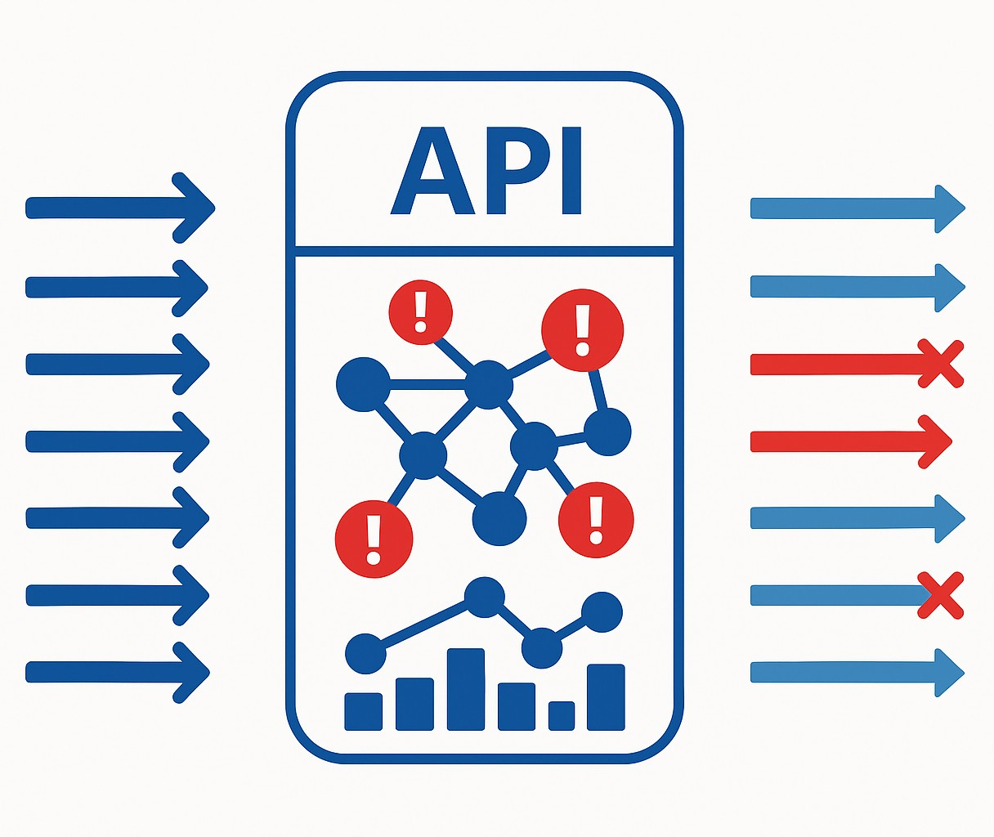
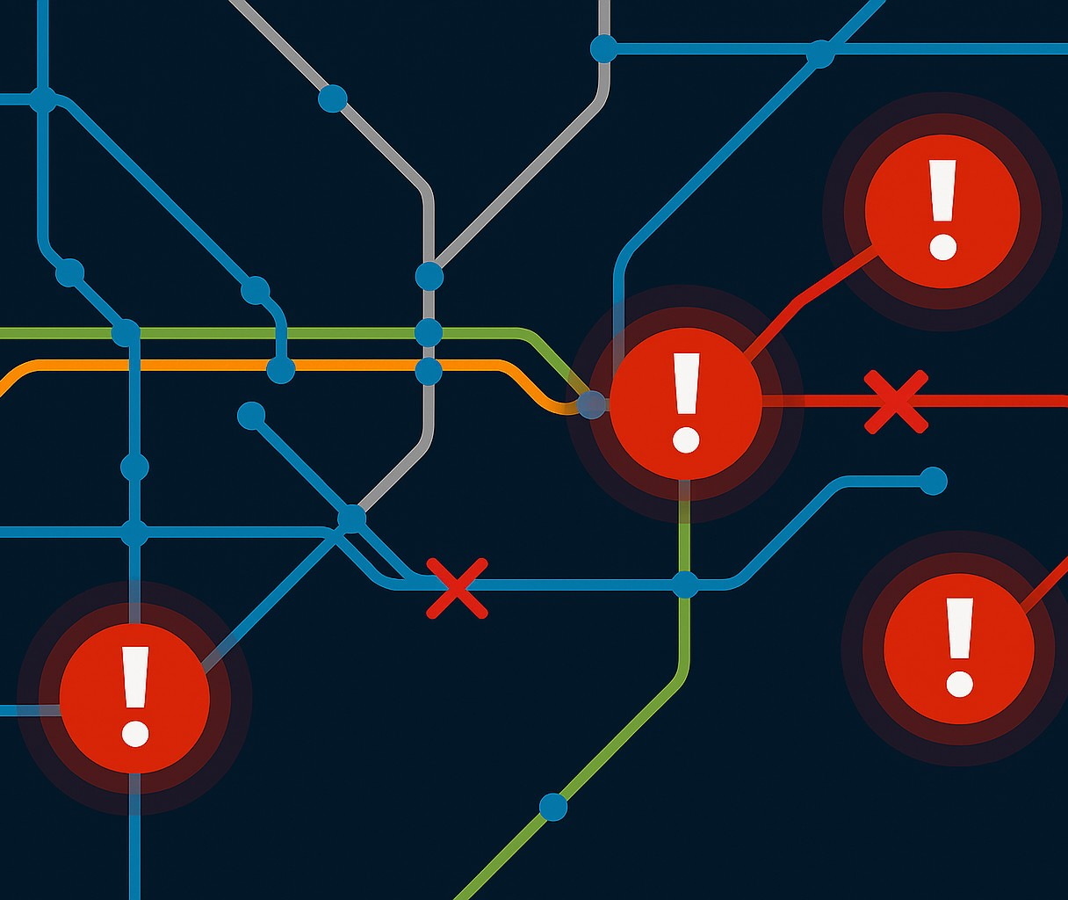
The Resilience Challenge
Building Resilient and Scalable APIs in Azure
Notes:
London thrives on connections — the Tube, the buses, the river crossing. But when a signal failure hits at a major interchange, the disruption ripples across the network.
Your APIs are no different. A single point of failure — an upstream service, a database, a network link — can cause delays and errors far beyond its immediate scope.
And just like London’s transport system, you cannot simply shut down and wait for the problem to pass. You need alternate routes, real-time monitoring, and the ability to keep people — or data — moving.
The challenges are real: surges in demand, dependency failures, latency storms, deployment risks. The opportunity is to design systems that keep the city — or your platform — running no matter what.

Slide 4










Resilience Turnaround
From Fragile to Fault-Tolerant: An API Resilience Transformation
Before (Challenges)
After (Results from Azure Patterns & Services)
Legacy Stack
Unplanned Outages
Cascading Failures
Protected Gateway
Multi-Region
Smart Patterns
No visibility
Manual Recovery
Live Metrics
Scales on Demand
Notes:
Let me give you a realistic example.
There is an organization that started with a patchwork of legacy integration systems and a couple of home-grown API gateways. They were fine on a normal day, but when traffic spiked, the cracks showed. Requests piled up, upstream services failed, and without throttling or caching, these failures cascaded.
They had no real-time visibility, so they were always reacting after customers felt the pain. Every failover was manual, expensive in both time and money.
They decided to re-architect with resilience in mind, using the exact patterns and Azure services we will be talking about today. Azure API Management became their consistent front door, enforcing policies, caching responses, and shielding backends. They deployed across multiple regions with Azure Front Door, so it one region had trouble, traffic flowed seamlessly to another. They built retry and circuit breaker logic into both APIM and their service code. They also wired up Azure Monitor and Application Insights to spot trouble before users did.
The result? A platform that now takes traffic surges in stride, shrugs off upstream hiccups, and has cut downtime dramatically — all while delivering a 315% ROI. This is the kind of transformation we are aiming for in this session.

Slide 5
Azure Toolset Overview
Notes:
We have just experienced the reality of API resilience challenges — the surges, dependency failures, cascading slowdowns, and deployment risks.
London thrives on connections. From the Underground to the Thames crossing, the city’s lifeblood is its ability to keep people and goods moving, even when something goes wrong. When a signal failure hits a major interchange, the system does not stop — it reroutes, adapts, and keeps the flow going.
Resilient APIs work the same way. They are not the product of luck — they are the result of deliberate design choices that give you:
Control at the edge — like the ticket gates and signal systems that manage flow and prevent overcrowding.
Elasticity in the middle — like adding extra carriages or buses when demand surges.
Intelligence throughout — like Transport for London’s live monitoring that adjusts routes before delays cascade.
You can build those capabilities on many platforms — Kubernetes in AKS, App Service Web Apps, even traditional VMs — and the principles will apply to all of them.
For this session, though, we will focus on serverless technologies where possible. Why? Because serverless gives us some of those resilience superpowers right out of the box:
It scales automatically with demand — like putting more trains into service when the platforms are full.
It removes much of the operational overhead so that we can focus on the “transport plan” — the API logic and resilience patterns — instead of maintaining the “tracks and stations.”
And it aligns cost with usage, so you are not paying for empty trains at midnight.
Think of it as starting with a city that already has flexible infrastructure and on-demand capacity built in. We will still add the safety systems, the backup routes, and the monitoring, but the base is already designed to handle stress.
In this next section, we will examine the specific Azure building blocks that give us those capabilities and how they work together to create APIs that survive under pressure and keep the network running smoothly, just like London.

Slide 6

Azure Toolset Overview
Primary Trio
Azure API Management
Traffic Shaping and Throttling
Caching
Policy Enforcement
Backend Shielding
Notes:
Let’s start at the front door of our API platform, Azure API Management, or APIM.
APIM is like ticket gates and signal control rooms across the Underground network in London. Every passenger — or request — passes through here first. It’s where we check their credentials, decide which platform they should head to, and control the flow so the system doesn’t halt.
From a resilience perspective, APIM gives us several critical capabilities:
Traffic shaping and throttling: Like regulating entry at busy stations to prevent dangerous platform overcrowding.
Caching: Serving repeat requests instantly, the way a contactless tap speeds you through without re-processing entry fare.
Policy enforcement: Applying consistent rules for authentication, transformation, and validation, just as TfL applies uniform standards across all lines.
Backend shielding: Insulating fragile or high-latency services from the chaos of rush-hour demand.
This is where we can implement circuit breakers, retries, and failover routing at the edge — stopping problems before they cascade deeper into the system.
Because APIM is a single, consistent entry point for all APIs, we can roll out resilience patterns once and have them apply everywhere—just like a central control center can adjust signals and schedules across the entire city in real time.
In short, APIM is our first line of defense and our first opportunity to optimize. It is where we absorb the initial shock of a traffic surge, gracefully handle upstream issues, and keep the rest of the platform stable — just as London’s transport system keeps the city moving, even when the pressure is on.

Slide 7

Azure Toolset Overview
Primary Trio
Azure API Management
Azure Functions
Elastic Capacity
Scale-to-Zero Efficiency
Event-Driven Triggers
Isolation of Workloads
Notes:
After APIM has managed the flow at the front door, we need a way to handle the work itself when demand changes instantly.
In London terms, Azure Functions is like the extra buses or Tube trains that appear when a big event lets out — or the maintenance crews that work overnight and vanish by morning.
From a resilience perspective, Functions gives us:
Elastic Capacity — like adding more carriages to clear a rush-hour crowd.
Scale-to-zero efficiency — no empty trains running through the night.
Event-driven triggers — responding to live signals from the network.
Isolation of workloads — each “crew” works independently, so one delay doesn’t ripple across the whole system.
It’s our on-demand workforce — ready to respond instantly, then step back when the work is done.

Slide 8

Azure Toolset Overview
Primary Trio
Azure API Management
Azure Functions
Azure Container Apps
Granular Scaling
Multiple Scale Triggers
Revisions and Blue-Green Deployments
Service-to-Service Communication
Notes:
After APIM has managed the flow at the edge and Functions has handled the quick, event-driven work, we need a way to run continuous core services that can flex with demand.
In Berlin terms, Azure Container Apps is like the Tubes lines that run all day — but can add more trains when the platforms are packed, or reroute services when there’s a signal failure.
From a resilience perspective, Container Apps gives us:
Granular scaling — like adding or removing trains based on passenger load.
Multiple scale triggers — responding to live passenger data, not just a timetable.
Revisions and blue-green deployments — like trialing a new timetable on one line before applying it across the network.
Service-to-service communication — secure, internal “track links” between lines without sending passengers above ground.
It is our flexible backbone — always running, but able to adapt instantly when the city’s needs change.

Slide 9







Who is Chad Green?
chadgreen@chadgreen.com
TaleLearnCode
ChadGreen.com
ChadGreen & TaleLearnCode
ChadwickEGreen

